Slide 1


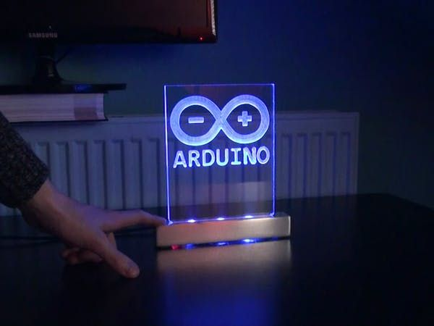
INTRODUCTION
What is an Object Avoiding Robot?
An object-avoiding robot is an autonomous robot that uses sensors to detect obstacles in its path and automatically navigates around them without human intervention.
Purpose:
To build a robot that can autonomously avoid obstacles.
Applications:
Robotics competitions.
Home automation and cleaning robots.
Industrial applications like warehouse management.

Slide 2
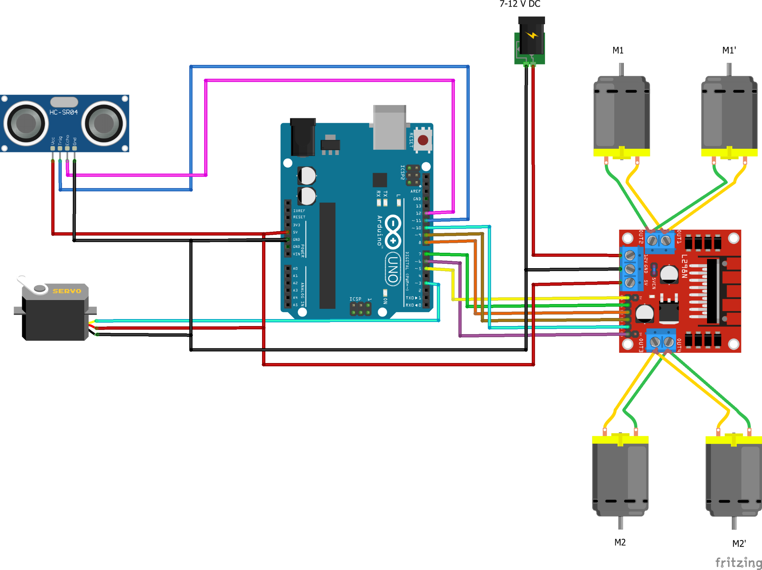
METHODOLGY
Overview:
The object-avoiding robot operates using an Arduino microcontroller, ultrasonic sensors, and motor drivers to detect and navigate around obstacles.
Working Principle:
The ultrasonic sensor measures the distance to nearby objects.
If an obstacle is detected within a specified distance, the robot stops and adjusts its direction.
The servo motor rotates to scan for the best path.
The robot chooses the path with the maximum distance and resumes moving.

Slide 3
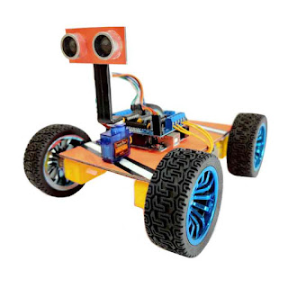
SYSTEM ARCHITECTURE
1
Diagram:
Arduino UNO
Ultrasonic Sensor (HC-SR04)
Servo Motor (SG90)
Motor Driver (L298N)
DC Motors (Right & Left)
2
Explanation:
Arduino UNO: The brain of the robot, controlling all operations.
Ultrasonic Sensor: Detects obstacles and measures distances.
Servo Motor: Rotates to check left and right distances.
Motor Driver: Controls the speed and direction of DC motors.

Slide 4
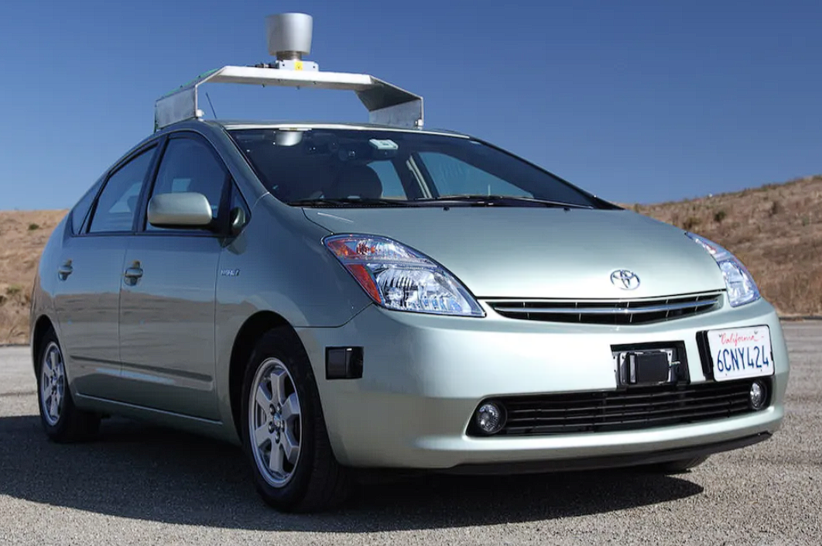
ADVANTAGES &
DISADVANTAGES
1
A Self Driving Car
Advantages
Autonomous navigation without human intervention.
Simple and cost-effective design.
Easy to program and modify for different applications.
Can be enhanced with additional sensors for better obstacle detection.
2
Disadvantages
Limited obstacle detection range due to ultrasonic sensor limitations.
Ineffective on highly reflective or absorbent surfaces.
Works best only on flat surfaces; difficult to navigate uneven terrain.
Limited battery life depending on motor usage.

Slide 5

FUTURE
SCOPE
Enhancements:
Integration of AI for better decision-making.
Adding multiple sensors for 360-degree obstacle detection.
Using LiDAR or infrared sensors for improved accuracy.
Incorporation of GPS for autonomous outdoor navigation.
Applications:
Home automation robots.
Delivery robots.
Industrial automation systems.

Slide 6
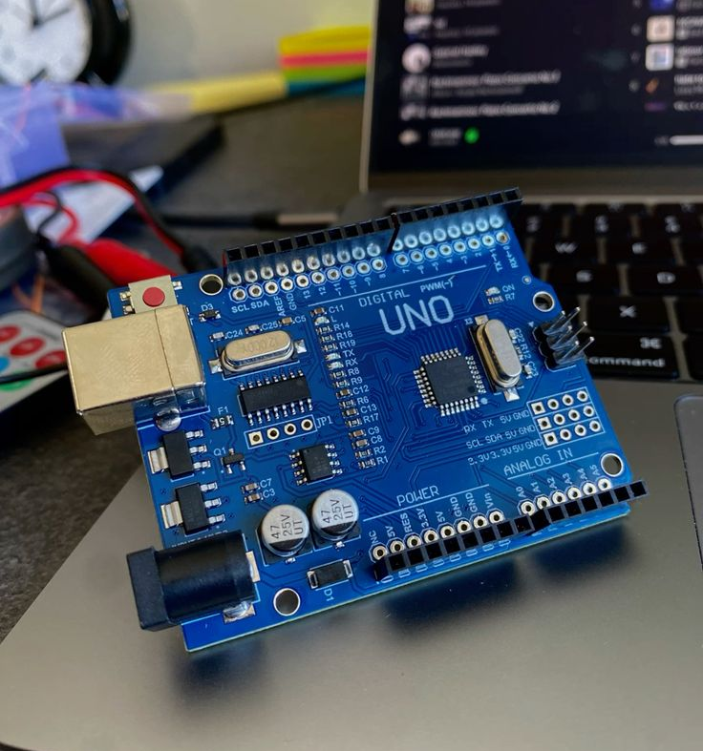
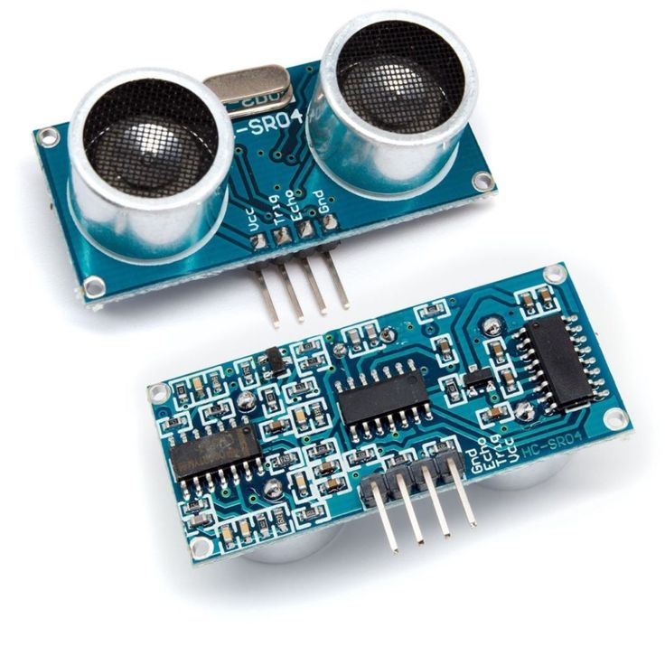
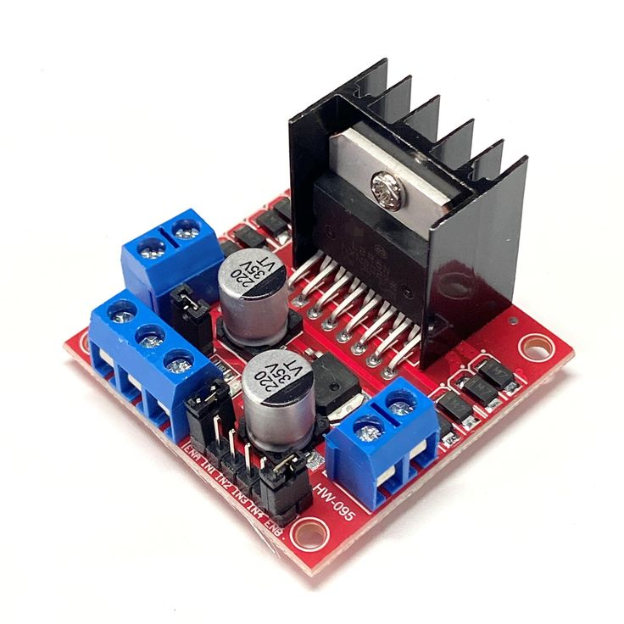
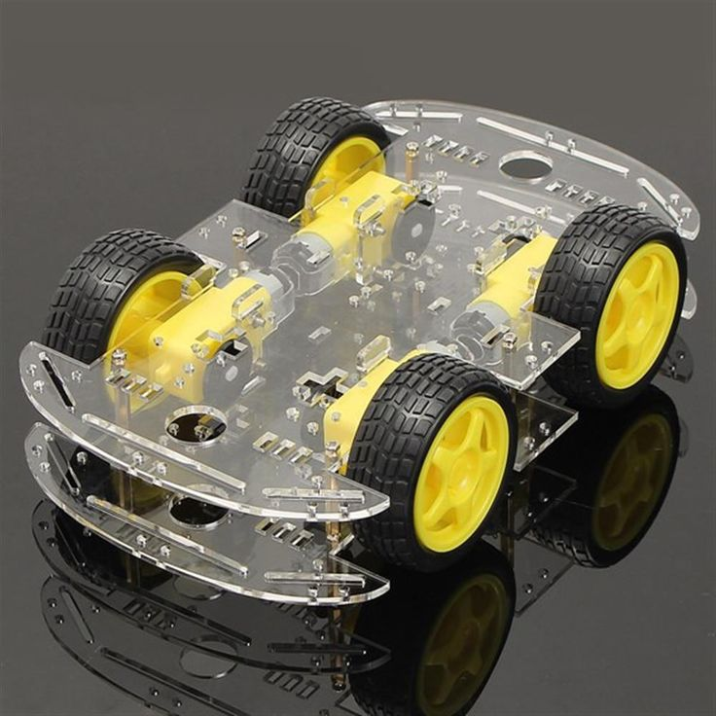
CONCLUSION
Conclusion
The object-avoiding robot is a simple yet powerful demonstration of autonomous robotic systems.
It highlights the practical application of Arduino in robotics and automation.
This project can be a foundation for developing more complex and intelligent robotic systems in the future.

Slide 7
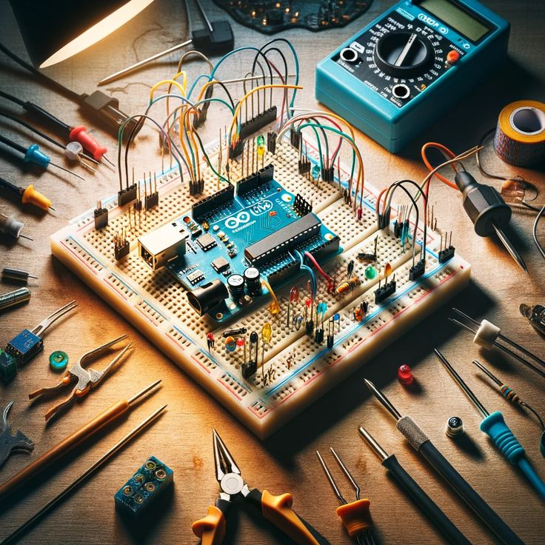
REFERENCE
GitHub. (2021,April 8). Obstacle Avoiding Car [Repository]. Retrieved from https://github.com/un0038998/ObstacleAvoidingCar

